Slide 1
Secure data hiding in image using steganography
CAPSTONE PROJECT
Presented By: MOHAMED SALMAN AL FARISH A
Student Name : MOHAMED SALMAN AL FARISH A
College Name & Department : M .Kumarasamy College Of Engineering & Electronics And Communication Engineering

Slide 2
OUTLINE
Problem Statement
Technology used
Wow factor
End users
Result
Conclusion
Git-hub Link

Slide 3
Problem Statement
In the digital world, secure data transmission is crucial to prevent unauthorized access. Traditional encryption methods can be easily detected, making hidden communication vulnerable. Steganography offers a solution by embedding secret data within images without altering their appearance. However, many existing techniques lack robustness against steganalysis and potential security breaches..

Slide 4
Technology used
Language: Python
Platform: Windows
Libraries used
Image Processing:
OpenCV – Used for image manipulation and pre processing
Steganography Techniques:
Stegno – To perform LSB (Least Significant Bit) steganography

Slide 5
WOW FACTORS
Hides data invisibly using techniques like LSB, DCT, and wavelet transform.
Enhances security with encryption and resists steganalysis detection.
Supports multiple formats (images, audio, video, text) with lossless recovery.
Maintains data integrity with lossless recovery and resistance to modifications like compression or resizing.

Slide 6
End users
Helps protect sensitive information from cyber threats and unauthorized interception.
Enables safe sharing of sensitive reports without detection or censorship.
Used to investigate cybercrimes, detect hidden threats, and track illegal activities.
Combining encryption and steganography ensures that even if the hidden data is detected, it remains unreadable without the decryption key.

Slide 7
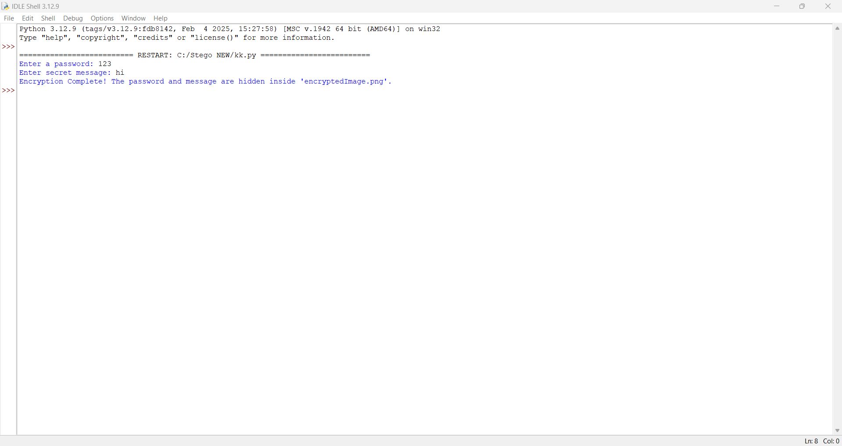
Results

Slide 8
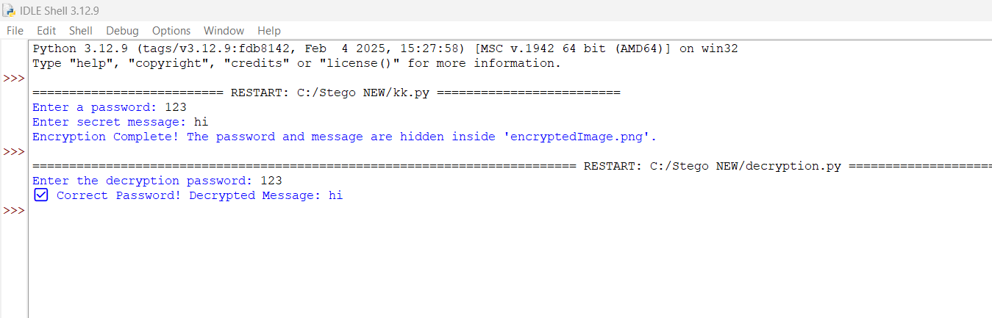

Slide 9


Slide 10
Conclusion
Steganography is a secure and discreet method for hiding sensitive data within digital media. It enhances privacy by ensuring covert communication without altering the visible appearance of the carrier file. Combining encryption with steganography adds an extra layer of protection, making hidden data resistant to cyber threats. Its applications span across cybersecurity, finance, and digital watermarking. As digital security threats continue to evolve, steganography remains a reliable, future-proof solution for safeguarding confidential information. This technique plays a crucial role in modern data protection and secure communication.

Slide 11
GitHub Link
https://github.com/salman2kjs/EDUNET.git

Slide 12
THANK YOU

